Slide 1
Flairdocs Workflow Designer Project
By the Null Pointers

Slide 2
Project Mission and Objectives
Create a design tool help speed up creating customizable, automated workflows. By creating this product, system administrators will be able to make configurable workflows without the need of a software developer.
Usable
Configurable
Functional
Accessible

Slide 3
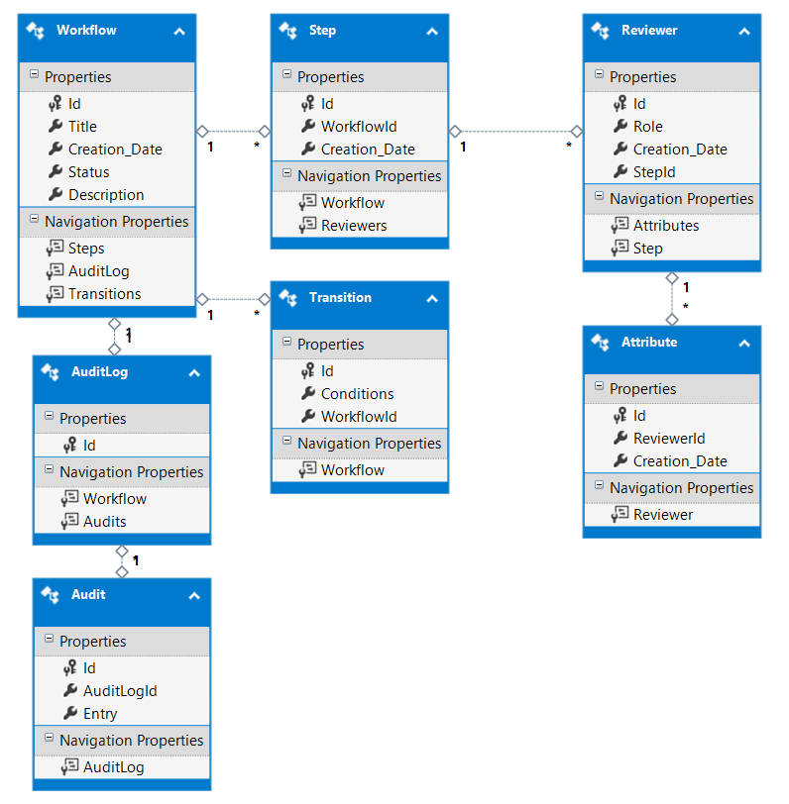

Slide 4
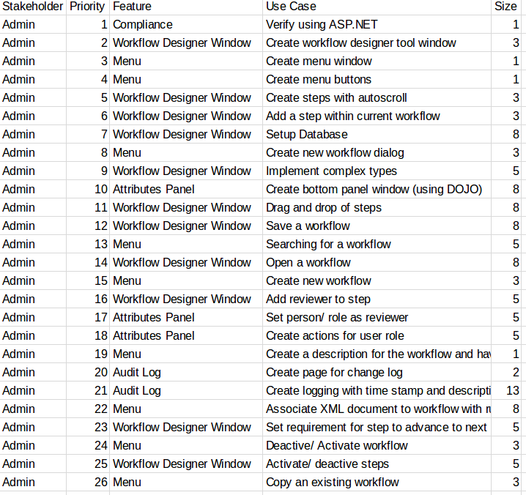

Slide 5
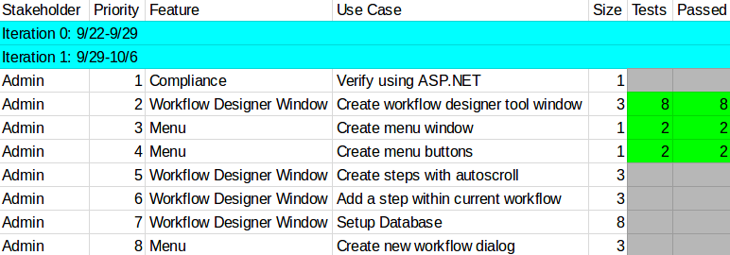
Demo 1 Requirement Traceability Matrix

Slide 6
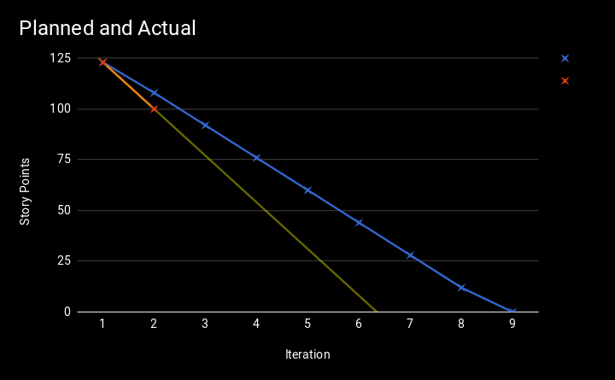
Release Burndown Chart
Date | Iteration | Planned | Actual
9/22 | 0 | 123 | 123
9/29 | 1 | 123 | 123
10/6 | 2 | 108 | 100
10/13 | 3 | 92
10/20 | 4 | 76
10/27 | 5 | 60
11/3 | 6 | 44
11/10 | 7 | 28
11/17 | 8 | 12
11/24 | 9 | 0
Planned
Actual

Slide 7
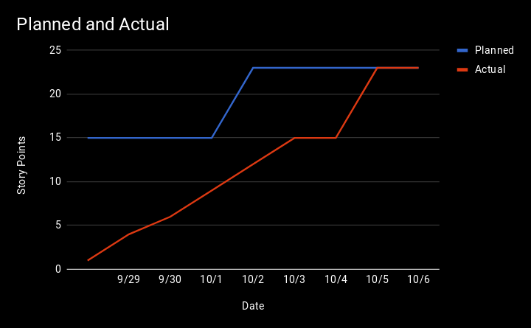
Iteration Burnup Chart
Date | Planned | Actual | Added | Done
Prior | 15 | 1 | 0 | 1
9/29 | 15 | 4 | 0 | 3
9/30 | 15 | 6 | 0 | 2
10/1 | 15 | 9 | 0 | 3
10/2 | 23 | 12 | 8 | 3
10/3 | 23 | 15 | 0 | 3
10/4 | 23 | 15 | 0 | 0
10/5 | 23 | 23 | 0 | 8
10/6 | 23 | 23 | 0 | 0

Slide 8
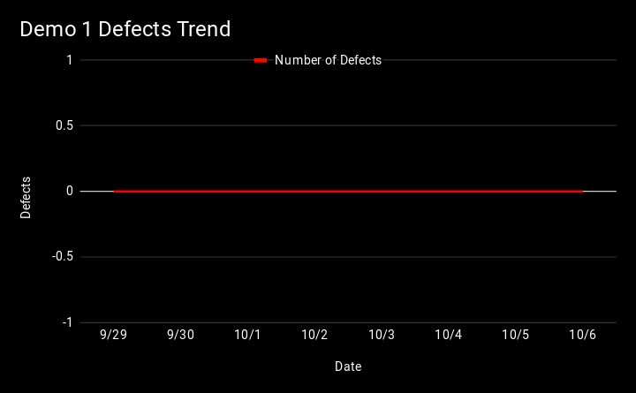
Defect Trend Chart
Date | Total Defects | Found | Closed
Prior | 0 | 0 | 0
9/29 | 0 | 0 | 0
9/30 | 0 | 0 | 0
10/1 | 0 | 0 | 0
10/2 | 0 | 0 | 0
10/3 | 0 | 0 | 0
10/4 | 0 | 0 | 0
10/5 | 0 | 0 | 0
10/6 | 0 | 0 | 0

Slide 9
Regression Test Suite

Slide 10
Live Demo

